Slide 1
TO THE SERVICES OF
THE NORTH RIDGEVILLE CHURCH OF CHRIST
Scripture taken from the New King James Version®.
Copyright © 1982 by Thomas Nelson. Used by permission. All rights reserved.

Slide 2


Slide 3

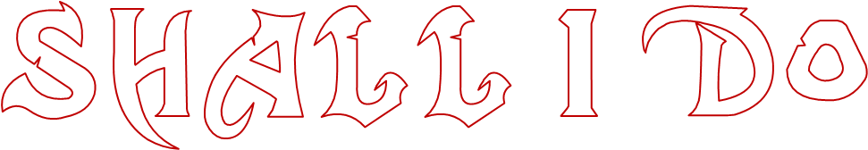
what
JESUS?
with
MATTHEW 27:15-22

Slide 4
“I’ll Sell Him!”
Matthew 26:14-16
THE GREEDY

Slide 5
“I’ll Deny Him!”
Matthew 26:69-77
Mk. 14:54
John 18:18
2 Timothy 2:12, “If we endure, We shall also reign with Him. If we deny Him, He also will deny us.”
THE FEARFUL

Slide 6
“I’ll Crucify Him!”
Matthew 27:18, 23
Matthew 5:21, 22
John 15:24, 25
“Envy” is associated with hypocrisy, malice, evil speaking, and hatred (1 Pet. 2:1; Titus 3:3)
THE ENVIOUS

Slide 7
“I’ll Persecute Him!”
Galatians 1:13, 14
Acts 9:1-5
THE ZEALOUS ENEMY

Slide 8
“I’m Neutral Toward Him!”
Matthew 27:24
Acts 24:24, 25
Matthew 12:30 | Luke 16:13
THE POLITICIAN

Slide 9
“I’m Almost Persuaded By Him!”
Acts 26:27, 28
THE UNCONVERTED

Slide 10
“I’ll Gladly Receive Him!”
Acts 2:37-42
MANY OTHERS ALSO
Samaria had received the word – Acts 8:14
The Gentiles received the word – Acts 11:1
The Bereans received the word – Acts 17:11
The Thessalonians received the word
– 1 Thess. 1:6; 2:13
THE SAVED

Slide 11
“He who rejects Me, and does not receive My words, has that which judges him—the word that I have spoken will judge him in the last day.”
John 12:48

Slide 12
“Jesus answered and said to him, "If anyone loves Me, he will keep My word; and My Father will love him, and We will come to him and make Our home with him.”
John 14:23

Slide 13
I’ll sell Him.
I’ll deny Him.
I’ll crucify Him.
I’ll persecute Him.
I’m neutral toward Him.
I’m almost persuaded by Him.
I’ll gladly receive Him.
WHAT IS YOUR JUDGMENT OF JESUS?

Slide 14
“For we must all appear before the judgment seat of Christ, that each one may receive the things done in the body, according to what he has done, whether good or bad.”
2 Corinthians 5:10

