Slide 1
What WORK has GOD given the CHURCH to do?
Acts 11:19-30
Scripture taken from the New King James Version®.
Copyright © 1982 by Thomas Nelson. Used by permission. All rights reserved.

Slide 2
Giving
1 Cor. 16:1-3
2 Cor. 9:6, 7
Singing (spiritual, vocal, congr.)
Eph. 5:19
Communion
Lk. 22:14-20
1 Cor. 11:23-29
Acts 20:7
The Mission of the Church
Baptism
DIVINE Authority
Identity
Human Reasoning
Prov. 14:12
Matt. 15:8, 9
Bind amount, other days, bake sales, etc.
Choir, instrum. music
The Church
1 priceless church, a defined work carried out by local congregations
Another day, changed elements, manner, etc.
Col. 3:17
Identity
“Christian”
Acts 26:28
Acts 11:26
1 Pet. 4:16
denominationalism, humanitarianism, institutionalism
Sectarian names

Slide 3


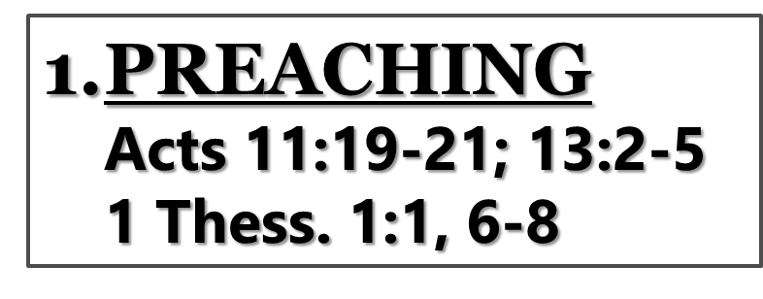
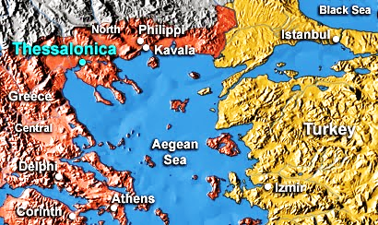
This Photo by Unknown Author is licensed under CC BY-NC-ND

Slide 4
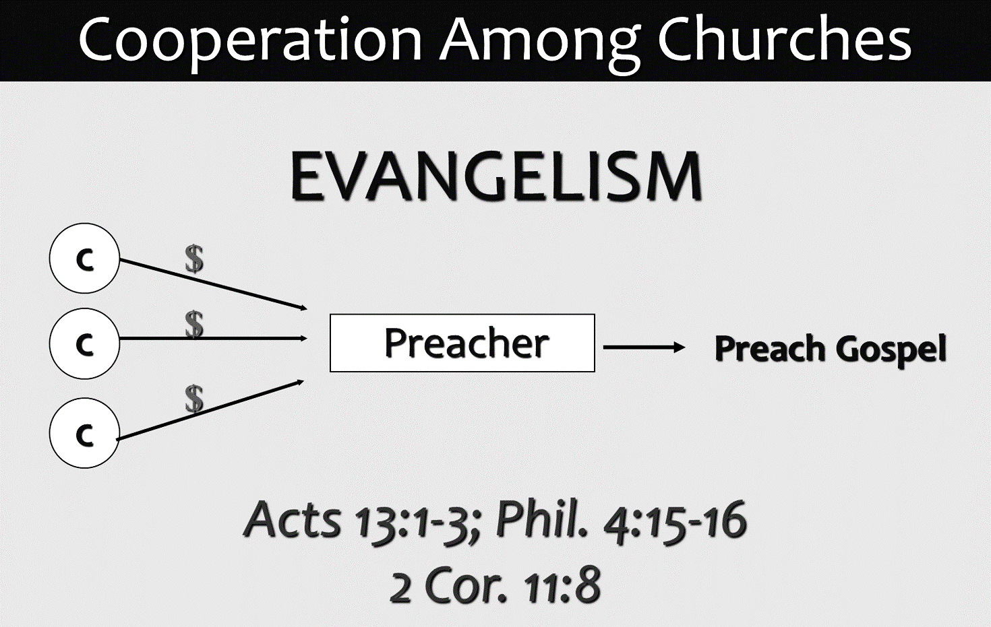

Slide 5
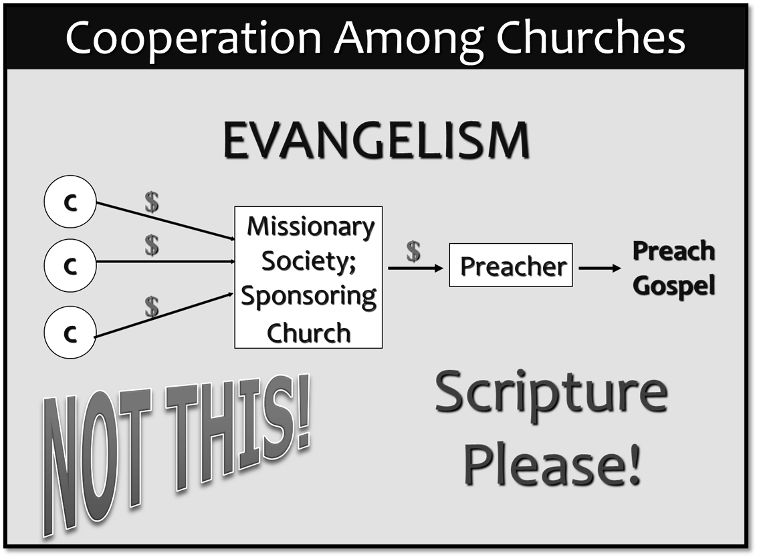

Slide 6
“It should be noted that there was no elaborate organization for the discharge of these charitable functions. The contributions were sent directly to the elders by the churches who raised the offerings.”
Woods, Guy N., Annual Lesson Commentary of Gospel Advocate Co. p. 338. 1946
PREACHING
Acts 11:19-21; 13:2-5
1 Thess. 1:1, 6-8
EDIFICATION
Matt. 28:20; Acts 11:22-26; 1 Tim. 4:6
BENEVOLENCE
Acts 11:27-30

Slide 7
benevolence to
IMPOVERISHED SAINTS
Raised for needy
saints
1 Cor. 16:1-3
Rom. 15:26
Sent to saints
Rom. 15:25
Received by saints
Rom. 15:31
Supplied the needs of saints
Rom. 15:27
2 Cor. 9:12, 13

Slide 8
