Slide 2
The PURPOSE of the WORK of the CHURCH!
Ephesians 4:11-16
Scripture taken from the New King James Version®.
Copyright © 1982 by Thomas Nelson. Used by permission. All rights reserved.

Slide 3
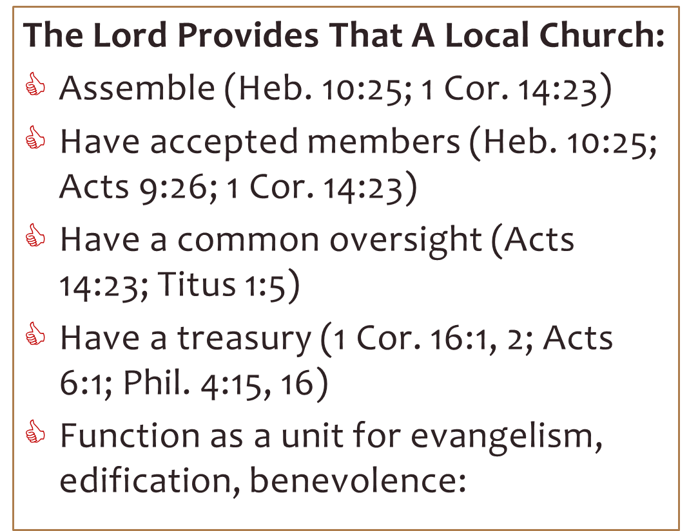
WHAT WORK?
And for what PURPOSE?

Slide 4
The PURPOSE of the WORK of the CHURCH!
To save the lost—bringing them to the grounds of reconciliation with God
  Eph. 1:7; 2:13, 16-18
To keep the saved, saved—forming Christ within every member of the body
  Eph. 4:20-24

Slide 5


the PURPOSE of the WORK!
Ephesians 4:12
for the equipping of the saints
picture, Matt. 4:21 | 2 Cor. 13:9-11

Slide 6
Motivational Speeches
0r
Instructional Teaching?
John 8:31 – “Then Jesus said to those Jews who believed Him, "If you abide in My word, you are My disciples indeed.”
Acts 2:42 – “And they continued steadfastly in the apostles’ doctrine…”
Acts 20:7 – “Now on the first day of the week, when the disciples came together to break bread, Paul, ready to depart the next day, spoke to them and continued his message until midnight.”
“FOR THE EQUIPPING OF THE SAINTS”

Slide 7
Motivational Speeches
0r
Instructional Teaching?
Acts 16:4, 5 – “And as they went through the cities, they delivered to them the decrees to keep, which were determined by the apostles and elders at Jerusalem. So the churches were strengthened in the faith, and increased in number daily.”
1 Cor. 11:2 – “Now I praise you, brethren, that you remember me in all things and keep the traditions just as I delivered them to you.”
“FOR THE EQUIPPING OF THE SAINTS”

Slide 8



“Having a form of godliness but denying its power. And from such people turn away!”
My little children, for whom I labor in birth again until Christ is formed in you, I would like to be present with you now and to change my tone; for I have doubts about you.
2 Timothy 3:5
Galatians 4:19, 20

Slide 9

Breakfast
0r
Instructional Teaching?
1 Cor. 11:22 – “What! Do you not have houses to eat and drink in? Or do you despise the church of God and shame those who have nothing? What shall I say to you? Shall I praise you in this? I do not praise you.”
“FOR THE EQUIPPING OF THE SAINTS”

Slide 10
the PURPOSE of the WORK!
Ephesians 4:12
for the equipping of the saints
picture, Matt. 4:21 | 2 Cor. 13:9-11
for the work of ministry
prim. spiritual, Eph. 4:13, 14; cf. 1 Thess. 5:12-14

Slide 11
The Threefold Goal of the “Work of Ministry” – Eph. 4:13
TO THE UNITY OF THE FAITH
OF THE KNOWLEDGE OF THE SON OF GOD
TO A PERFECT MAN
  5046/téleios, “This root (tel-) means ‘reaching the end (aim)’ and is illustrated by an old pirate's telescope – unfolding (extending) one stage at a time to function at full-capacity (effectiveness).”
HELPS Word-studies taken from The Discovery Bible, available at discoverybible.com, copyright © 2021, HELPS Ministries Inc. Used by permission. All rights reserved.

Slide 12
the PURPOSE of the WORK!
Ephesians 4:12
for the equipping of the saints
picture, Matt. 4:21 | 2 Cor. 13:9-11
for the work of ministry
prim. spiritual, Eph. 4:13, 14; cf. 1 Thess. 5:12-14

Slide 13
the PURPOSE of the WORK!
Ephesians 4:12
for the equipping of the saints
picture, Matt. 4:21 | 2 Cor. 13:9-11
for the work of ministry
prim. spiritual, Eph. 4:13, 14; cf. 1 Thess. 5:12-14
for the edifying of the body of Christ
Eph. 4:15, 16; Acts 2:44-47; 8:1, 3, 4; 11:19-21

Slide 14

WHAT MUST I DO TO BE SAVED (Acts 16)?
30 And he brought them out and said, "Sirs, what must I do to be saved?"
31 So they said, "Believe on the Lord Jesus Christ, and you will be saved, you and your household."
32 Then they spoke the word of the Lord to him and to all who were in his house.
33 And he took them the same hour of the night and washed their stripes. And immediately he and all his family were baptized.
34 Now when he had brought them into his house, he set food before them; and he rejoiced, having believed in God with all his household.

