Slide 1
WELCOME!
Scripture taken from the New King James Version®.
Copyright © 1982 by Thomas Nelson. Used by permission. All rights reserved.

Slide 2
PRIDE
& Divine Limitations
PROVERBS 25:28
“Whoever [has] no rule over his own spirit [Is like] a city broken down, without walls.”

Slide 3
PRIDE
& Divine Limitations
PROVERBS 13:10
“By pride comes nothing but strife, But with the well-advised [is] wisdom.”

Slide 4
PRIDE
Pride corrupted those giving to the church
(Acts 5:1-10)
Pride corrupted the church’s use of her spiritual gifts
(1 Cor. 12-14)

Slide 5
DESTRUCTION & PRIDE
  Promotes division – 1 Cor. 1:12, 13
    Versus humility – Eph. 4:1-3; Jn. 15:14
  Challenges divine authority
  – 2 Chron. 26:16
    Versus humility – Lk. 5:5
  Replaces the mission of God’s commission
  – 1 Sam. 15:1-23
    Versus humility – Col. 3:12-17
“Pride goes before destruction, And a haughty spirit before a fall” (Prov. 16:18)

Slide 6
DESTRUCTION & PRIDE
  Ignores limitations
    Limitations for inspired men – 1 Cor. 14:27ff
    Presumption – Deut. 17:8-13; Psa. 19:13
    Add to/subtract from – Deut. 4:2; Rev. 22:18, 19
“Pride goes before destruction, And a haughty spirit before a fall” (Prov. 16:18)

Slide 7


WIDOWS – 1 Timothy 5:3-16
Widows versus real widows
Individual versus congregational responsibility
restr ctions
Is the church limited in the area of benevolence?

Slide 8

Acts 2:38
remission of sins is limited for those who ?
Mark 16:16
Salvation is limited for those who ?
No emotionally supercharged argument will change what these verses say.

Slide 9
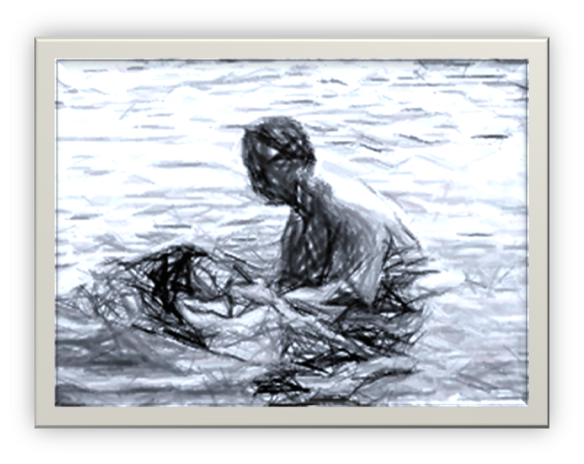
ACTS 10:47, 48
"Can anyone forbid water, that these should not be baptized who have received the Holy Spirit just as we have?"
And he commanded them to be baptized in the name of the Lord. Then they asked him to stay a few days.

