Slide 1
WELCOME!
Scripture taken from the New King James Version®.
Copyright © 1982 by Thomas Nelson. Used by permission. All rights reserved.

Slide 2
Jude 1:11 & Worship
Jude 1:11, “Woe to them! For they have gone in the way of Cain, have run greedily in the error of Balaam for profit, and perished in the rebellion of Korah.”

Slide 3
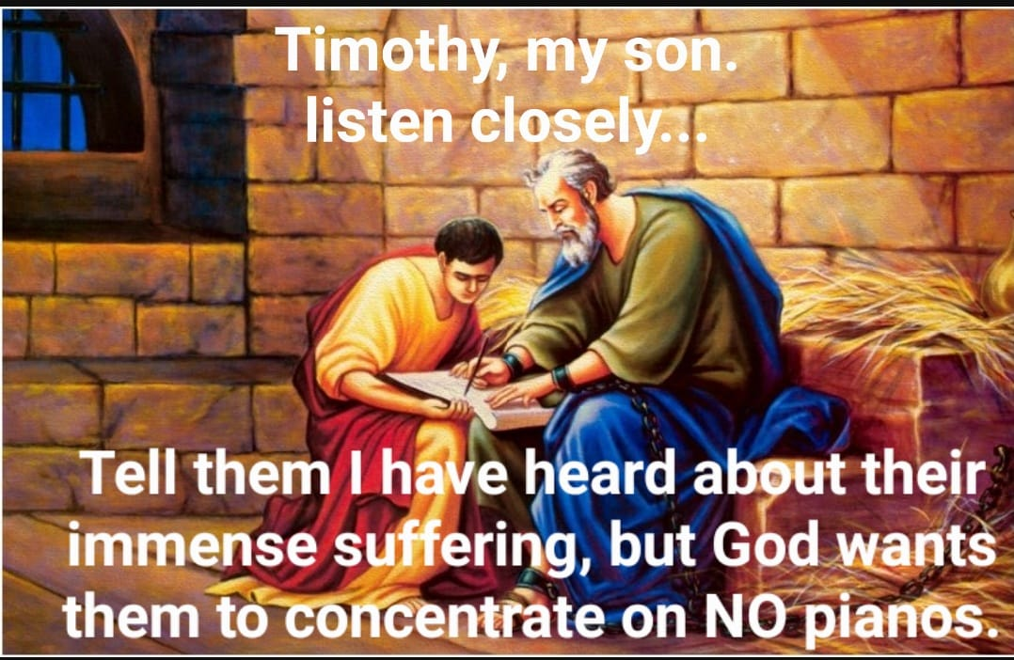
A Modernist Mocks the Lord’s Church
MODERNISM – “The deliberate departure from tradition and the use of innovative forms of expression that distinguish many styles in the arts and literature of the 1900s.”

Slide 4
“IMMENSE SUFFERING” AND “THE TRUTH” IN PAUL’S SECOND LETTER TO TIMOTHY
Paul suffered for preaching, 1:11, 12
But Timothy must “Hold fast the pattern of sound words,” 1:13

Slide 5
2 Timothy 1:13
2 Timothy 1:14
Pattern of sound words
Hold Fast!
The good thing committed to you
Keep!

Slide 6
“IMMENSE SUFFERING” AND “THE TRUTH” IN PAUL’S SECOND LETTER TO TIMOTHY
Many have turned away from the truth, 1:15; 2:17, 18; 4:10, 14-16
  The rise of hypocrites with a form of godliness = added suffering, 3:1-5
  Men of corrupt minds resist the truth, 3:8
But Timothy you have carefully followed my doctrine, 3:10

Slide 7
“IMMENSE SUFFERING” AND “THE TRUTH” IN PAUL’S SECOND LETTER TO TIMOTHY
Persecution comes from living godly lives, 3:12; Imposters will grow worse, 3:13
But you, Timothy, must continue in the things you learned, 3:14
Scripture focused for being wise for salvation and equipped, 3:15-17
Endure hardships as a good soldier, 2:3, 4

Slide 8
“What in the world does Jude 1:11 have to do with worship?”
Jude 1:11, “Woe to them! For they have gone in the way of Cain, have run greedily in the error of Balaam for profit, and perished in the rebellion of Korah.”
WHO IS KORAH?
Numbers 16
Unauthorized offering, Num. 16:15, 31-35

Slide 9
“What in the world does Jude 1:11 have to do with worship?”
WHO IS BALAAM?
Numbers 22-24
Unauthorized religion, Num. 25:1-9
Why? See Num. 23:21; 31:8, 16

Slide 10
“What in the world does Jude 1:11 have to do with worship?”
WHO IS CAIN? (Genesis 4:1-15)
Unauthorized offering, Gen. 4:3-5; Heb. 11:4
1 John 3:12, “not as Cain [who] was of the wicked one and murdered his brother. And why did he murder him? Because his works were evil and his brother’s righteous.”

Slide 11
Warning Against Being Biblically Illiterate!
“Give diligence to present thyself approved unto God, a workman that needeth not to be ashamed, handling aright the word of truth.”
(2 Tim. 2:15, ASV)

Slide 12
Warning Against Will-Worship!
“Which things have indeed a show of wisdom in will-worship, and humility, and severity to the body; [but are] not of any value against the indulgence of the flesh.”
(Col. 2:23, ASV)

