Slide 2


In Humility
1 John 2:6, “He who says he abides in Him ought himself also to walk just as He walked.”
Scripture taken from the New King James Version®.
Copyright © 1982 by Thomas Nelson. Used by permission. All rights reserved.

Slide 3
Having the Mind of Christ
IS A COMMANDMENT TO ALL OF US!
“Let this mind be in you which was also in Christ Jesus” (Phil. 2:5)

Slide 4
Imitating the HUMILITY of CHRIST means:
I crucify selfish pride (2:3a).
I esteem others better than myself (2:3b).
  Not pursuing self-honor
  Not implementing self-ridicule

Slide 5
“Likewise you younger people, submit yourselves to your elders. Yes, all of you be submissive to one another, and be clothed with humility, for "God resists the proud, But gives grace to the humble.”
1 Peter 5:5

Slide 6
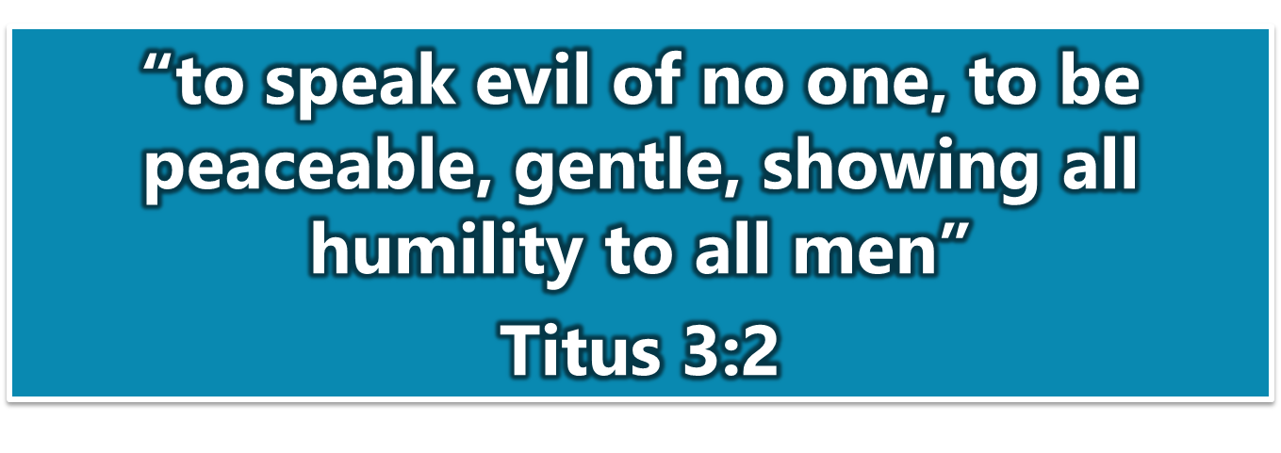
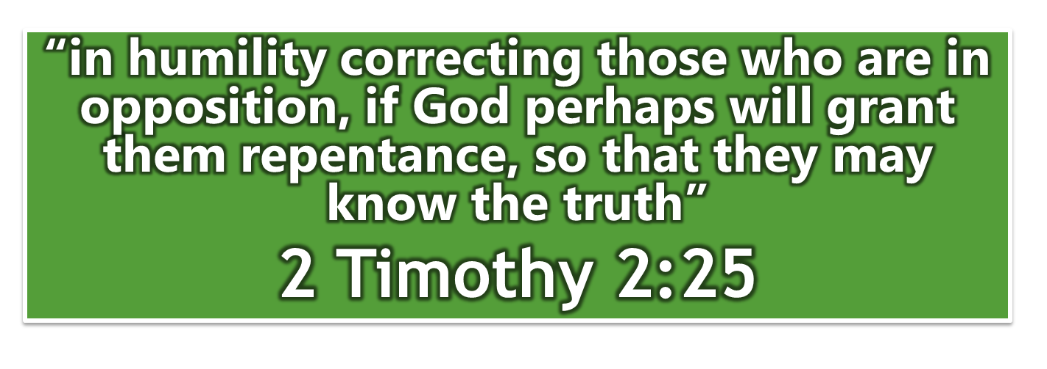

Slide 7
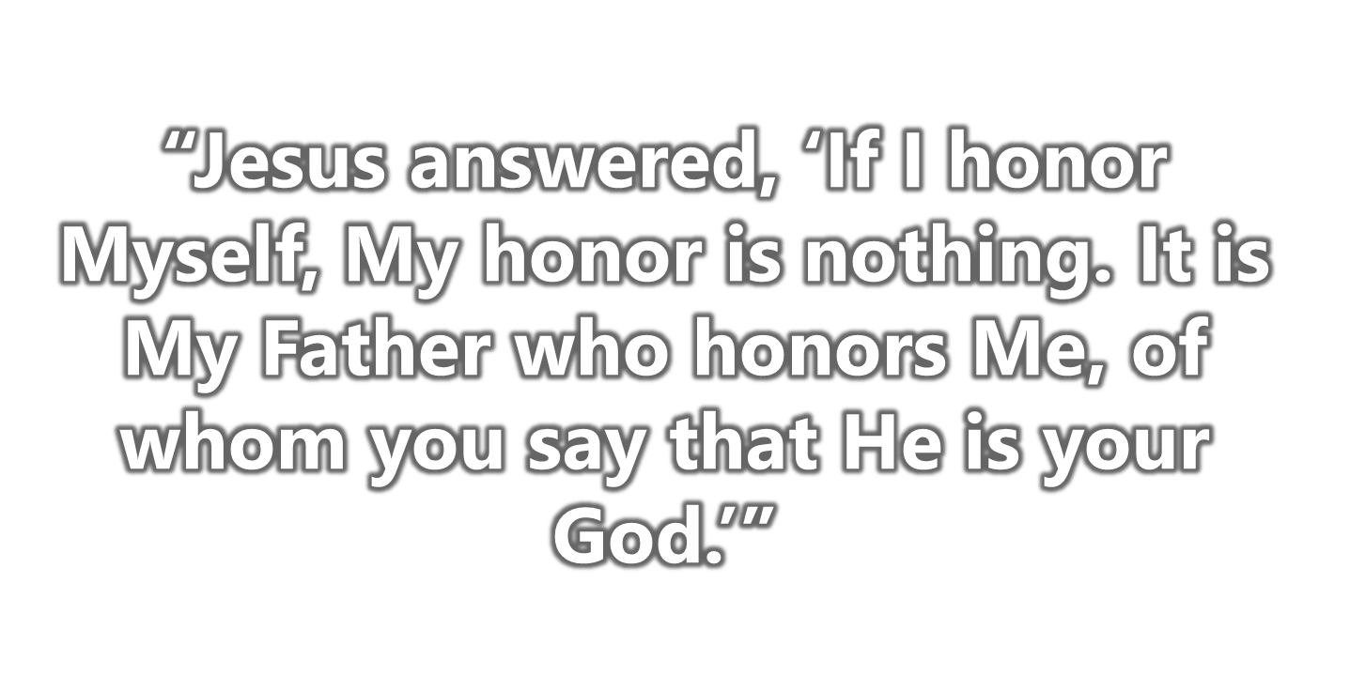
John 8:54

Slide 8
Imitating the HUMILITY of CHRIST means:
I crucify selfish pride (2:3a).
I esteem others better than myself (2:3b).
  Not pursuing self-honor
  Not implementing self-ridicule
  Practicing self-forgetfulness (Jn. 8:28, Lk. 22:42)

Slide 9
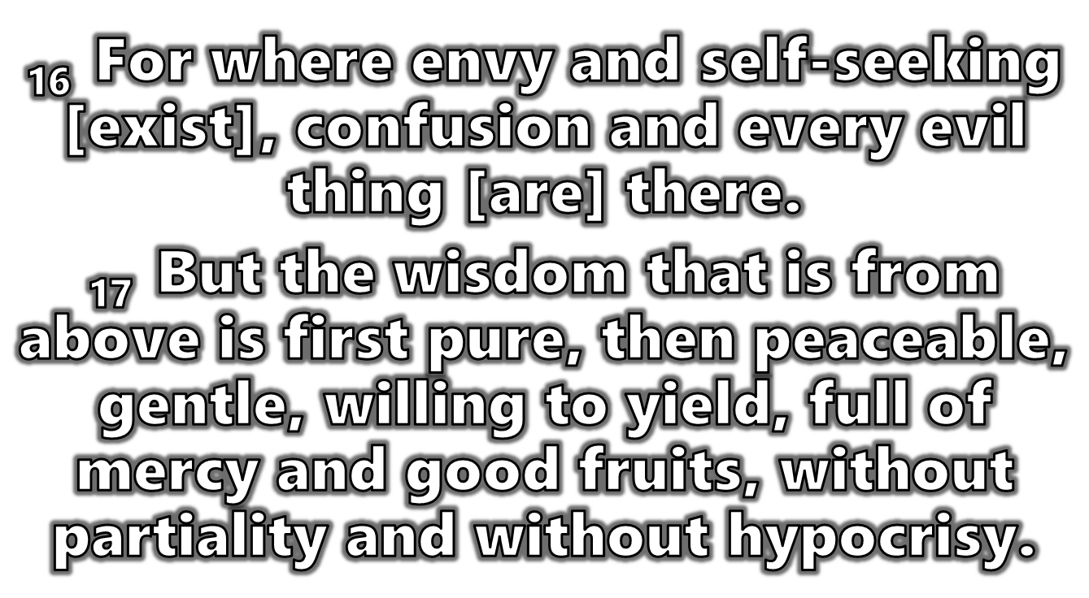
JAMES 3:16, 17

Slide 10
Imitating the HUMILITY of CHRIST means:
I crucify selfish pride (2:3a).
I esteem others better than myself (2:3b).
I look out for the interest of others (2:4).
I obey the will of God even if it costs me everything (2:8).
Romans 15:1, “We then who are strong ought to bear with the scruples of the weak, and not to please ourselves.”
Bow, confess, obey, work out, hold fast word (2:9-16)

Slide 11

“Brethren, join in following my example, and note those who so walk, as you have us for a PATTERN” (Phil. 3:17)

Slide 12
THE MIND OF CHRIST!
Securing contributions for needy saints (Rom. 15:22-29)
Pleading for prayers (Rom. 15:30, 31)
  Danger! Deliverance from unbelievers!
  Rejection! Service acceptable to saints!
Undeterred despite loving pleas, Acts 21:4, 8-14

Slide 13

WHY Did Paul Follow Though?
He had the mind of Christ
He had the humility of Christ
He practiced what he preached

Slide 14
Will You Have the Mind of Christ?
Will you OBEY the gospel and MEET the Lord in baptism (Col. 2:12, 13)?
Will you continue to WALK with the Lord by faithfully attending worship services and bible studies (Heb. 10:25; Rev. 2:10)?
Be equipped to TAKE the Lord to family, friends, foes, etc. (Eph. 4:12; Jn. 1:41, 46; 4:29; Acts 8:4)?

